Slide 1
ENTR Program Renewal
Dr Brad Anderson
Katherine Carpenter
Dr. Seanna Takacs

Slide 2
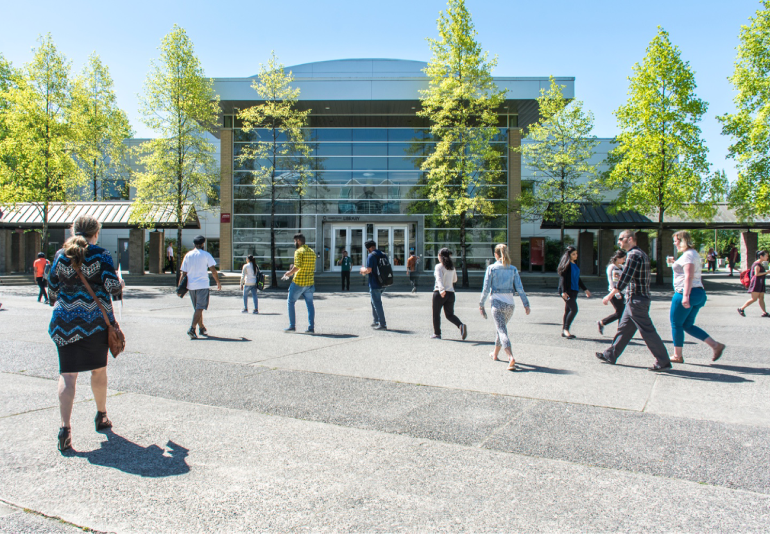
Kwantlen Polytechnic University
More than 20,000 students
Teaching-focused
Over 140 programs
Hands-on, practicum, work placements

Slide 3
A Bit of History

Slide 4
In 1999, The Entrepreneur Leadership program (ENTR) was launched as Kwantlen Polytechnic University’s first Bachelor of Business Administration program.
While 93.6% of ENTR graduates were employed after graduation, the program struggled with enrollment as the number of students enrolled in the program has declined over the years to 40% capacity.
Extensive consultation was conducted with industry and alumni, and current ENTR students undertook a lead role in redesigning this program to ensure its appeal, applicability, and relevance in today’s world.

Slide 5
Goals for ENTR Renewal
Attract a broader student base
Build on history of experiential learning
Clarify program’s intent for stakeholders
Align with ACBSP accreditation requirements
Modernize Program Learning Outcomes (PLOs)

Slide 6
Renewal Priorities
ENTR course should be open to all students by eliminating program restrictions and unnecessary prerequisites, wherever possible
Design for a fully online-compatible BBA
A spiral curriculum is to be designed with ENTR courses available in each semester of study
UDL in experiential projects/assessment drive all course delivery decisions
PRME principles are integrated throughout all ENTR courses

Slide 7
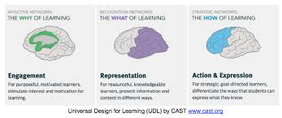
UDL
Barriers to educational participation
Barriers to class participation
Multiple paths through ENTR courses and the ENTR program
Developing representations of entrepreneurial identity to contextualize content
Voice and Choice in design

Slide 8
Spiral Curriculum
The student revisits a topic, theme or subject
The complexity of the topic, theme, or subject increases with each revisiting
New learning always has a relationship with old learning; all learning is contextualized
Bruner, 1960

Slide 9
Revised PLOs
Based on program renewal research, feedback from students, and consultation with ENTR Faculty, the following revised PLOS were developed: on program renewal research, feedback from students, and
PLO #1: Know Thyself - Entrepreneurial Identity
PLO #2: Create Opportunities
PLO #3: Mobilize
PLO #4: Grow

Slide 10
Revised PLO Definitions
PLO #1 Know Thyself - Entrepreneurial Identity | 1-1 Who Am I? 1-2 My Strengths 1-3 Motivators & Interests 1-4 Areas for Development
PLO #2 Create Opportunities | 2-1 Creative Curiosity 2-2 Ambiguity & Lenses 2-3 Knowledge Seeking 2-4 Idea Generation & Viability
PLO #3 Mobilize​ | 3-1 Curator of people, resources & ideas ​ 3-2 Creating organization/pathways ​ 3-3 Persuade ​ 3-4 Building Community​
PLO #4 Grow​ | 4-1 Defining My Success​ 4-2 Improvement Science​ 4-3 Trust, Abundance & Generosity​ 4-4 Pivot/Reinvent​

Slide 11
ENTR 1100 Entrepreneurial Inquiry
Students will explore their skills, motivators and interests as they relate to entrepreneurial thinking, in order to define their entrepreneurial identity. They will establish their entrepreneurial context through identification and investigation of their entrepreneurial areas of interest and world view.
New Course

Slide 12
ENTR 3010 Entrepreneurial Proposal
This course provides the opportunity for students to develop a proposal for an entrepreneurial opportunity. Bringing personal passions and practical plans together, students will self-assess for entrepreneurial ability, examine the landscape for entrepreneurial opportunities, assess the idea, analyze feasibility of the business idea, to create an entrepreneurial plan.
New Course

Slide 13
Where are we now?

Slide 14
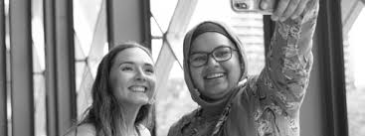
UDL in Action
ENTR 4110 – independent project course
100% student-driven
Students create projects & implement
Students define project goals
Students create project rubric

Slide 15
Student Projects
Flexible stat holidays
Group work resource
Biz plan/product development x2
Growing family businesses x2

Slide 16
Student Experience
“I liked how It gave me the opportunity to apply what I have learned into a real life vision for myself.”
Anecdotal (we’ve been live >1 year)
Positive word of mouth
“I honestly liked the way this class was a fun way of putting different classes together”
I liked pretty much everything!
Instructor / teaching style
Variety of activities
Freedom to work on a project in the same way you would in “real world” (long-term & setting own timeline)
Opportunity for career/ future planning & self-reflection

Slide 17
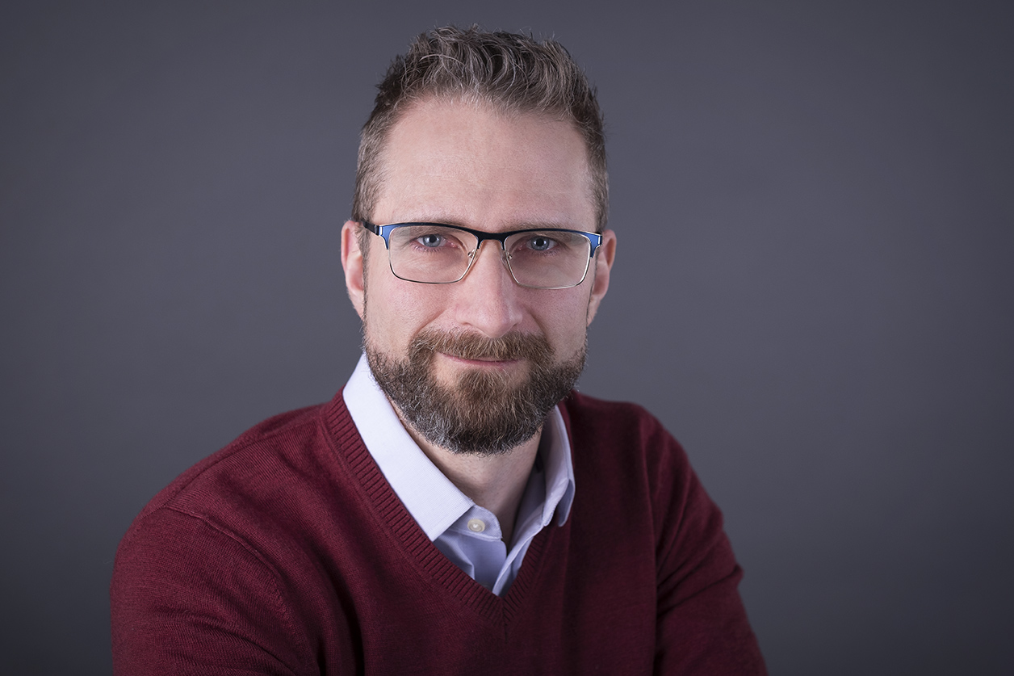
Our People Give It Reality
Core team committed to the mission
Proliferation of novel assessments
E.g. ungrading, contract grading
Zero textbook cost courses
Development of open-access resources

Slide 18
Secret to Building This Team
Clear articulation of our values
Ability to reflect and take risks together
Appreciation of the existing points of strength
Evaluating commitment to those values baked into recruitment

Slide 19
Assessing quality
PLOs established during program development
Currently developing assessment to collect performance data

Slide 20
The Future

Slide 21
Anticipated Challenges
New faculty “dilute” our culture
Lack of UDL expertise
Complacency
Reversion to status quo

Slide 22
Solutions – Culture Eats Policy
Lead with our values
Show & Tell → create atmosphere of collaboration/innovation
Lean on core faculty to mentor new hires
Create expectation we live our values

Slide 23
Professional Development
Develop program guidelines for PD
Bake UDL into guidelines

Slide 24
Student outreach
Case competitions
Business pitch competitions

Slide 25
Quality
Finish developing assessment plan
Do, measure, adapt, repeat

Slide 26
Wish us luck!

Slide 27
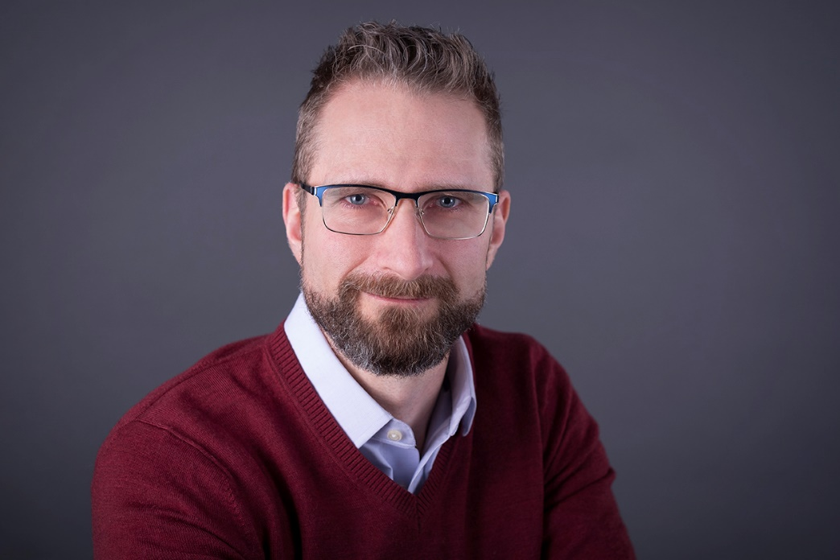
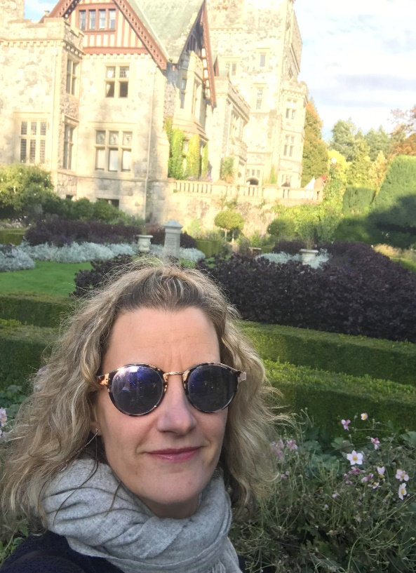
Contact Us
Brad Anderson, DBA Business Instructor Chair of Entrepreneurial Leadership
brad.Anderson@kpu.ca
Seanna Takacs, PhD
Accessibility Services/UDL Consultant
seanna.takacs@kpu.ca

